Slide 1
CS 4530: Fundamentals of Software Engineering Module 6, Lesson 3 Open Source
Rob Simmons
Khoury College of Computer Sciences

Slide 2
Learning Goals
By the end of this lesson, you should be able to…
Understand terminology and explain open source culture and principles
Opine on philosophical/political debate between open source and proprietary principles
Reason about tradeoffs of different open source licenses and business model

Slide 3
Background: laws and open source
Copyright protects creative, intellectual and artistic works — including software
Trademark protects the name and logo of a product
Patents protect designs and methods (certain algorithms are patented)
Copyright holder can grant a license for use, placing restrictions on how it can be used (perhaps for a fee)
Notes:
<read slide>

Slide 4
Some Unix History
Timeline
1970s: Bell Labs creates Unix, kind of gives it away for the price of the disks (AT&T not allowed to sell it as a product
1983: AT&T Unix party is over, competing paid OS versions
Also 1983: Richard Stallman announces “Starting this Thanksgiving I am going to write a complete Unix-compatible software system called GNU (Gnu’s Not Unix), and give it away free to everyone who can use it”
Notes:
1983 - Everything was pretty peach with AT&T’s Unix being used and improved in academia until 1983… when DOJ settled a new antitrust case against ATT, ATT then breaks up into the “baby bells” (regional operating companies like bell Atlantic; most of these are now verizon), meaning the ATT can now commercialize UNIX, which they do.
While the academics took their ATT UNIX license and created BSD, the suits at HP, Sun, IBM, and SGI all took their original UNIX license and created *their own* derived version of UNIX.
Some people looked at the state of affairs at the time and were concerned that this fragmentation would destroy any collective open-source efforts: Sun, HP, IBM, SGI et al are going to stop releasing the source of their derived UNIX OS, and will innovate in secret.
So, a character in our story named “Richard Stallman” then declares that he will solve this problem by re-writing a UNIX-compatible (but NOT UNIX) system from scratch that is

Slide 5
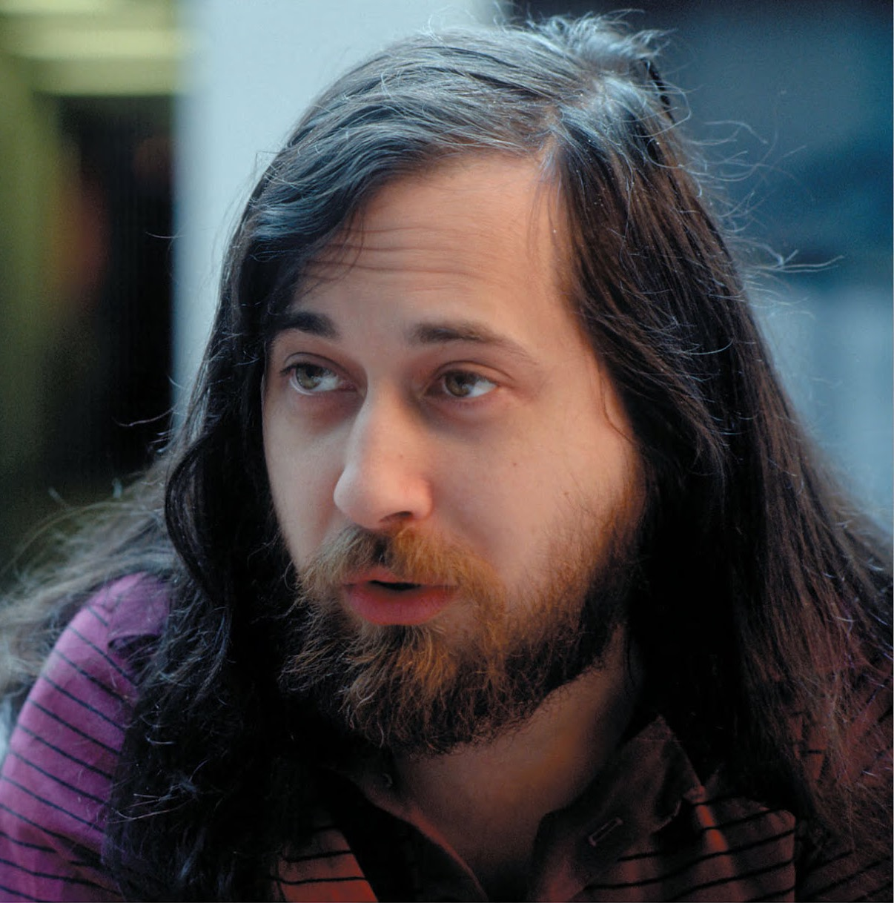
Free Software
Stallman’s project is an overtly ideological one:
Freedom 0: run code as you wish, for any purpose
Freedom 1: study how code works, and change it as you wish
Freedom 2: redistributed copies (of original) so you can help others
Freedom 3: distribute copies of your modified version to others
GPL is an interesting, unanticipated use of the existing licensing mechanism: you can use, but can only distribute if you distribute your changes under the same license.
Richard M Stallman (Licensed under GFDL)

Slide 6

More Unix History (Late ‘80s to early ‘90s)
Berkeley has a fork of AT&T’s Unix that they rewrite, license permissively (leave in the authors’ credit) — the BSD License
The GPL is used as the license for the Unix-like Linux “kernel”
Debian is a Linux distribution that wants to only use free software
Okay, what’s free software?

Slide 7
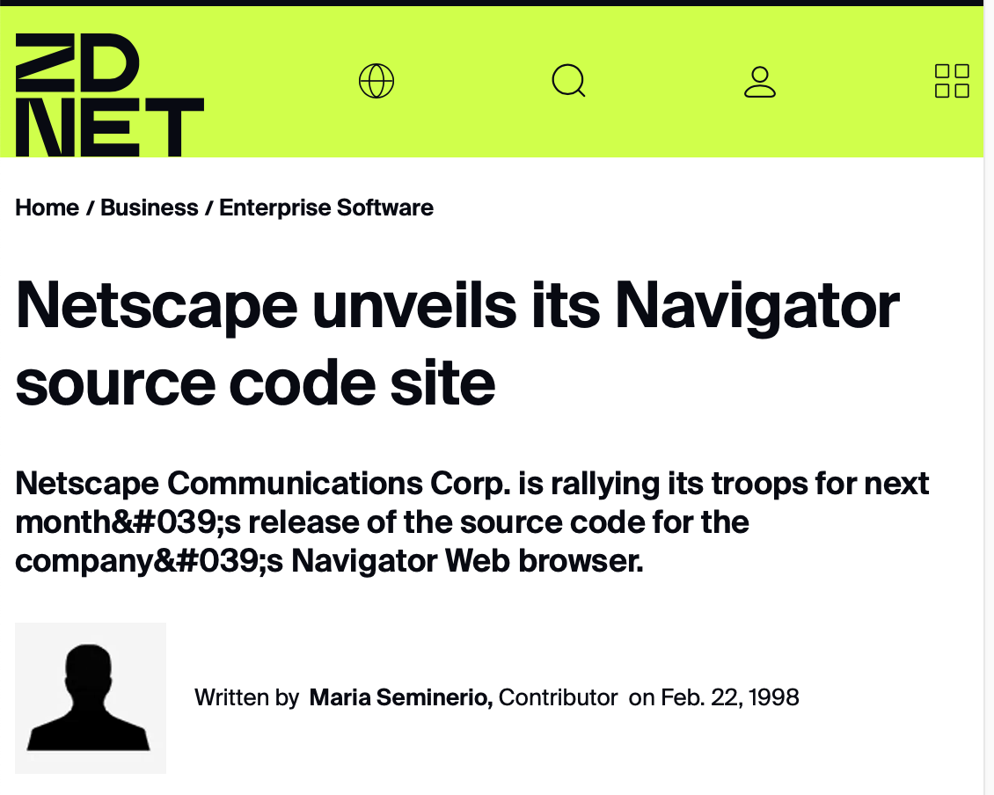
Some Browser History
Netscape was dominant web browser early 90’s
Business model: free for home and education use, companies pay
Microsoft entered browser market with Internet Explorer, bundled with Windows95, soon overtakes Netscape in usage (free with Windows)
January 1998: Netscape first company to open source code for proprietary product (Mozilla)
Netscape Public License
Usage Share of Netscape Navigator
Notes:
Lots of interesting details about netscape’s decision and process here - https://www.oreilly.com/openbook/opensources/book/netrev.html . Perhaps most interesting to discuss is the process around deciding the license (they used a public, somewhat democratic process to determine what licensing constraints should be). The vision was truly to “collaborate” with everyone building and using the web, rather than to try to create a singular ideal product (which is what they had previously been doing, and Microsoft beat them at)
Netscape did not call this open source!!!! They released a public website with their source code (“open source” was not yet coined)

Slide 8
Open Source
Open Software Initiative created to steward a definition of “open source”
Permissive licenses (MIT, BSD)
Free software/copyleft licenses (GNU, Mozilla Public License, Apache License)
Stallman: “Open Source is a development methodology; free software is a social movement”
Logo of the Open Software Initiative
Notes:
I personally think Stallman is wrong here — Open Source has its own set of ethics

Slide 9
Firefox lost battle, Open Source wins war
Firefox lost to Chrome and Safari, but OSS won
Chrome’s core = Chromium OSS
uses “Blink” rendering engine forked from WebKit
Safari’s core = Webkit OSS
forked from KHTML and KJS
Microsoft’s Edge core = Chromium
How do browsers differentiate?
Why is there more than one?
[By Datavizzer, CC BY-SA 4.0]
Notes:
"ChromiumOS" refers to an open-source project by Google based on the Linux kernel (3-clause BSD license). It includes its own rendering engine called "Blink," while "WebKit" is a separate rendering engine primarily used by Apple's Safari browser, which Chromium does not directly use;
Blink is a fork of WebKit (rendering engine)
WebKit started as a fork of the KHTML and KJS libraries from KDE (free software community).

Slide 10
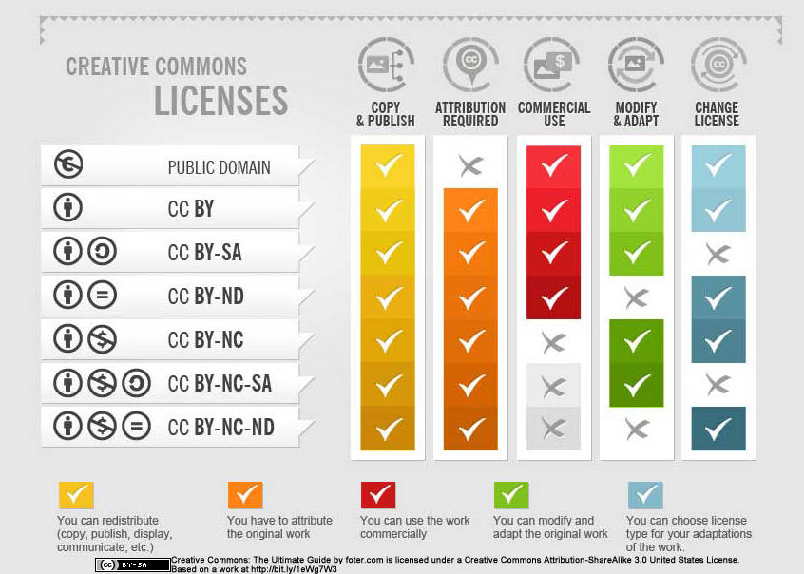
Creative Commons
https://creativecommons.org/share-your-work/cclicenses/
Notes:
<Read slide>
Explore more options

Slide 11
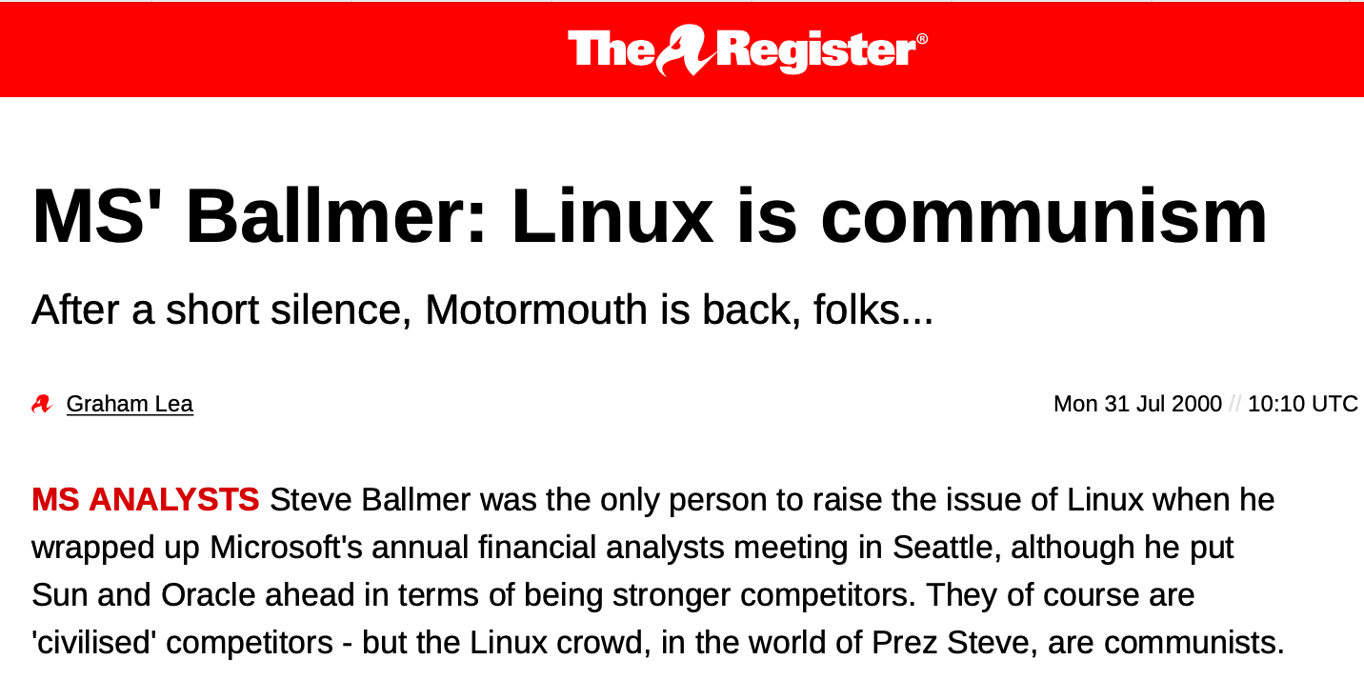
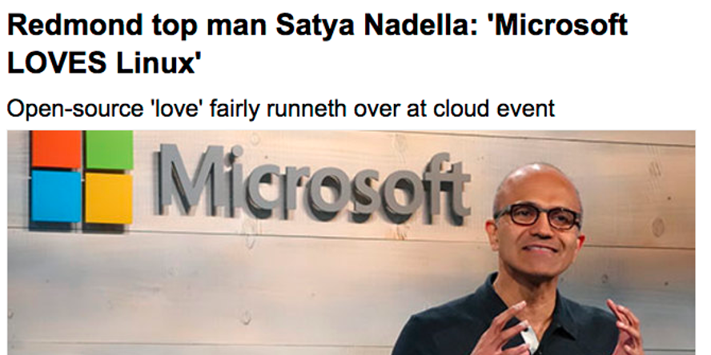
Business and OSS

Slide 12

Business and OSS
We estimate the supply-side value of widely-used OSS is $4.15 billion, but that the demand-side value is much larger at $8.8 trillion. We find that firms would need to spend 3.5 times more on software than they currently do if OSS did not exist.
https://www.hbs.edu/ris/Publication%20Files/24-038_51f8444f-502c-4139-8bf2-56eb4b65c58a.pdf

Slide 13


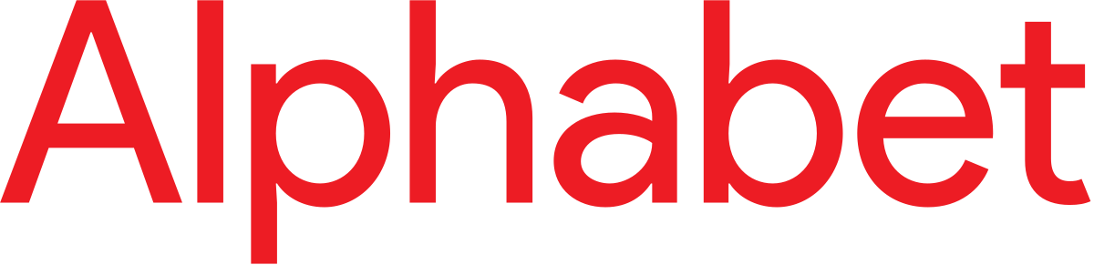





Business and OSS
Many of the most well-known open-source projects are primarily driven by singe large companies
Often outside contributors are required to assign copyright to central company, a “Contributor License Agreement”
Variety of motivations for companies here!
& React
& Chromium
& V8
& Typescript & Monaco (Visual Studio Code)

Slide 14
Adopting OSS has risks, tradeoffs
Are licenses compatible?
Including permissive-licensed software in copyleft-licensed software is generally compatible (copyleft takes precedence)
A significant concern for licenses with copyleft: Adopting libraries with copyleft clause generally means what you distribute must also have same copyleft clause (and be open source)
Are you certain that the software truly is released under the license that is stated? Did all contributors agree to that license?
LLM-driven violation of copyright norms makes whole situation very volatile
Notes:
The problem of “is the software really released under that license” is what exposed Google to Oracle’s suit
Note that we are not discussing software patents because that would be another lecture :)

